Slide 1


Facies Classification using Supervised Machine Learning
Final Machine Learning Project - Sekolah Data Pacmann
By : Stefanus Yudi Irwan
Date : November 2022
pacmann.io
© 2022 – Pacmann AI
Notes:
Hello, my Name is Stefanus Yudi Irwan, for you today, I will explain my Data Analysis portfolio with Title “Insurance Charge Data Analysis”. I made this to fulfill my final project for Pacmann Data Academy in Indonesia in The Probability Course.

Slide 2
Outline
Problem Definition & Goals
Project Timeline
Data Preparation
Data Preprocessing
Feature Engineering
Modeling
Model Evaluation
Front End and Back End Services
Pytest
Deployment

Slide 3
Problem Definition & Goals

Slide 4


Problem Definition
Business Problems
Oil and Gas companies need to translate well measurement data into lithofacies layer to better understand the condition of the reservoir being drilled.
Manually interpreting well measurement data that are exponentially growing in volume by reservoir geologists or geophysicists must be subjective to some extent, leading to increased uncertainties.
Facies definition is sometimes very time-consuming activity and expensive.
Business Solution
Classification of Lithofacies can be achieved by using supervised machine learning technique. This supervised technique used lithofacies labeled data to understand the patterns and then label other data lithofacies based on trained lithofacies patterns
In this research and deployment we will construct supervised machine learning model to classify lithofacies using well-measurement data to reduce cost and tackle the uncertainty of manual interpretation

Slide 5
Goals
The goal of this project is to find the best-supervised machine learning algorithm for lithofacies classification, and then deploy the pre-application to the server to predict the lithofacies from the well-measurement data
Machine Learning Metrics
Business Metrics
How well does the model predicts the true positive and true negative labels from the data input
Cost that was spent to interpret the well measurement data
Accuracy
0.5 – 0.6
1. Cost
2. Adjacent Accuracy
0.6-0.8
How well does the model predicts the adjacent facies of the labels
2. Work Execution Time
Time spent to interpret the well measurement data
3. CV Score
0.5-0.6
How is the model performance through training and validation data
4. ROC-AUC Value
0.8-0.9
How well the model can separate the True Positive and False Positive

Slide 6
Project Timeline

Slide 7
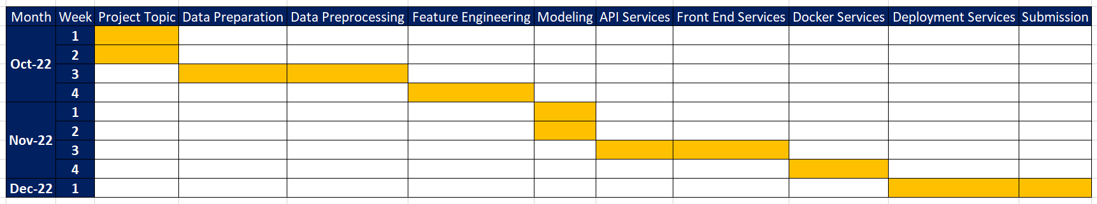
Project Timeline
Project Timeline : October Week 1 – December Week 1
Project Steps : Topic ➔ Data Preparation ➔ Data Processing ➔ Feature Engineering ➔ Modeling ➔ API Services ➔ Front End Services ➔ Docker Services ➔ Deployment ➔ Submision and Reporting

Slide 8













Project Tools
Developing ML
Front End & Back End
Deployment

Slide 9
Data Preparation
Notes:
Next we will talk about the dataset for this insurance charge analysis

Slide 10
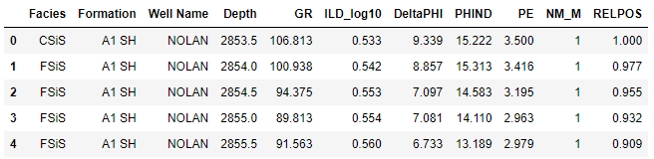
Dataset
Dataset are from Machine Learning Competition in 2016
Dataset comprises 11 columns and 4149 rows
There are 3 categorical data: Facies, Formation, and Well Name
There are 7 numerical data: Depth, GR, ILD_log10, Delta-PHI, PHIND, PE, NM_M, RELPOS
Numerical data consist of 5 Wireline Measurement and 2 Geological Variable

Slide 11
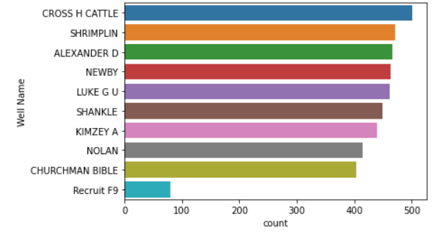
Dataset
Dataset consist of data measurement from 9 real well and 1 synthetic well (F9) to compensate category BS (Phyloid-Algae Bafflestone) in other well
The difference on the amount of data from the real well wasn’t so significant, but it is significant in the synthetic well

Slide 12
Data Preprocessing
Notes:
First analysis we will look at the central tendencies of the data through descriptive statistics analysis

Slide 13
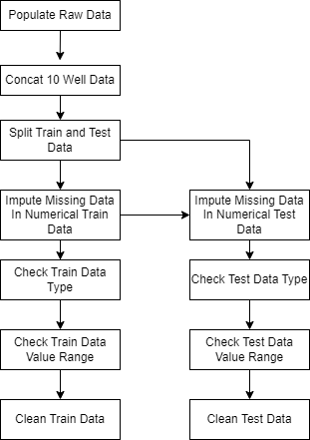
Data Preprocessing
Raw data is comprised of 10 CSV files that represent the well measurement from 10 different well
Well ‘CHURCHMAN BIBLE’ was used to become the test data well, and the rest of the 9 well data serve as train data
There are missing value in numerical data, and then it’s imputed by mean value for every label categories
Every data in train data and test data checked for data type and important range value

Slide 14
Feature Engineering

Slide 15
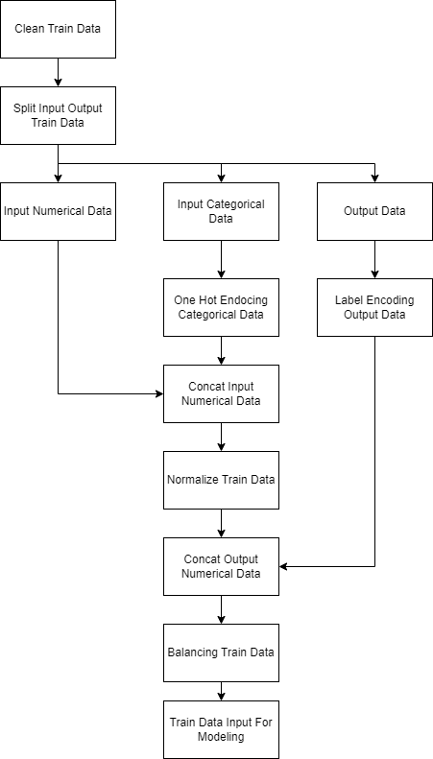
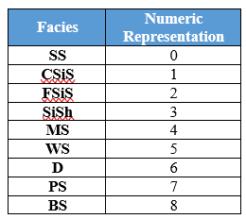
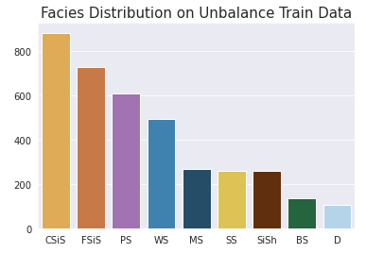
Feature Engineering
Drop feature Formation, Well Name, Depth, and RELPOS, then split numerical, categorical, and output data
One Hot Encoding for feature NM_M
Label Encoding for feature output facies
Normalize Input to have mean = 0 and standard deviation = 1
Balancing train data using random under sampling, random over sampling, and smote

Slide 16
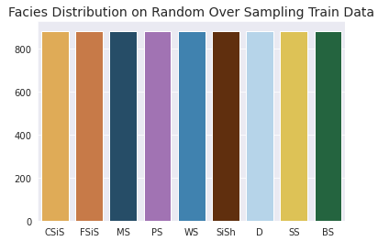
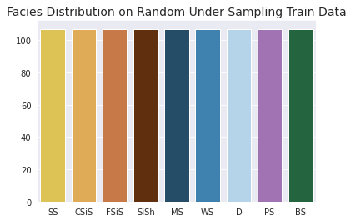
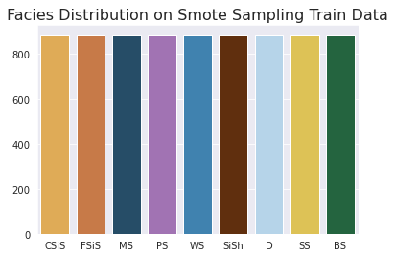
Dataset for Modeling
Unbalance
Random Over Sample
3745 data point for training
Facies unbalance
7956 data point for training
Facies balance
Random Under Sample
SMOTE
963 data point for training
Facies balance
7956 data point for training
Facies balance

Slide 17
Modeling

Slide 18
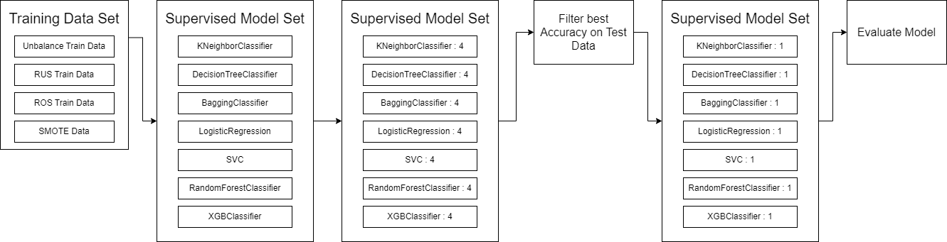
Modeling
Seven supervised model algorithm was trained by using four training data set, that will produce 28 machine learning model
From every algorithm will be picked one with the best accuracy on data test
From this 7 machine learning model will be picked one the best for facies classifier

Slide 19
Model Evaluation

Slide 20
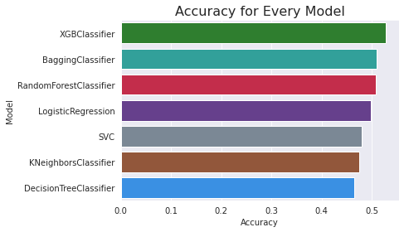
Evaluation by Accuracy Score
All model have accuracy below 0.6
XGBClassifier has the highest accuracy on test data (“CHURCHMAN BIBLE”) for 52.7% and Decision Tree Classifier has the smallest accuracy on test data for 46.5%

Slide 21
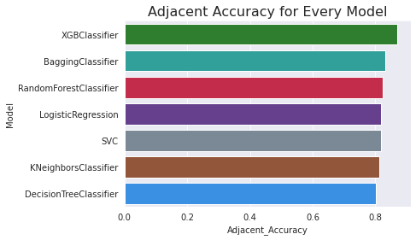
Evaluation by Adjacent Accuracy
All model have adjacent accuracy more than 0.8
XGB Classifier again has the highest adjacent facies value for 86,8% and again Decision Tree Classifier become the model with the smallest adjacent accuracy on test data for 80,2%

Slide 22
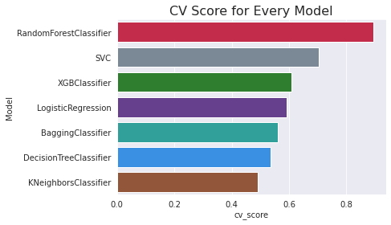
Evaluation by CV Score
Random Forest Classifier has the highest cv-score for 89.34%, whereas KNN has the smallest cv-score for 49,1%.
Random forest and svc have a high difference between CV score and accuracy, we can say that for this two model is overfit on train data, eventhough already pass the cross validation process.
For acceptable CV Score XGB Classifier has the highest cv score for 60.85% whereas KNN has the smallest cv score for 49,1%.

Slide 23
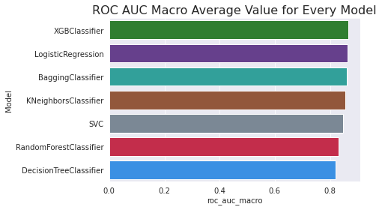
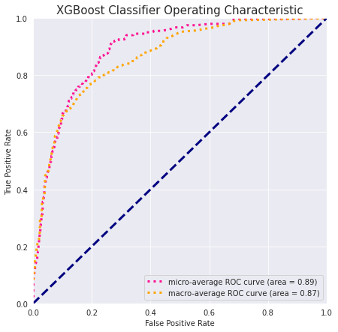
Evaluation by ROC-AUC
All model have roc-auc more than 0.8
XGB Classifier has the highest ROC-AUC score of 86.5% whereas Decision Tree Classifier has the smallest roc-auc score of 82%.
For multi-class classification ROC-AUC curve was constructed by computing average TPR and FPR for every category.

Slide 24
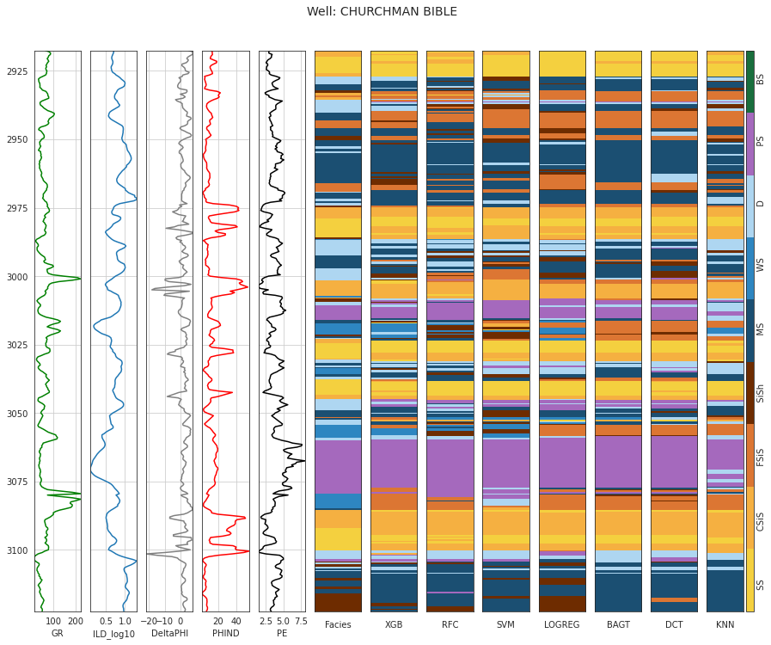
Evaluation by Prediction Result
every model could predict the majority of facies when the layer doesn’t variate much, like at the depth around 3075 and 2960
But when it comes to variative layer like in the depth around 3050 and 3100 the predicted lithofacies become clearly different with actual facies.
XGB Classifier with the best performance evaluated from accuracy, adjacent accuracy, cv-score, and ROC-AUC curve could predict the lithofacies layer better than any other model.

Slide 25
Front End and Back End Services

Slide 26
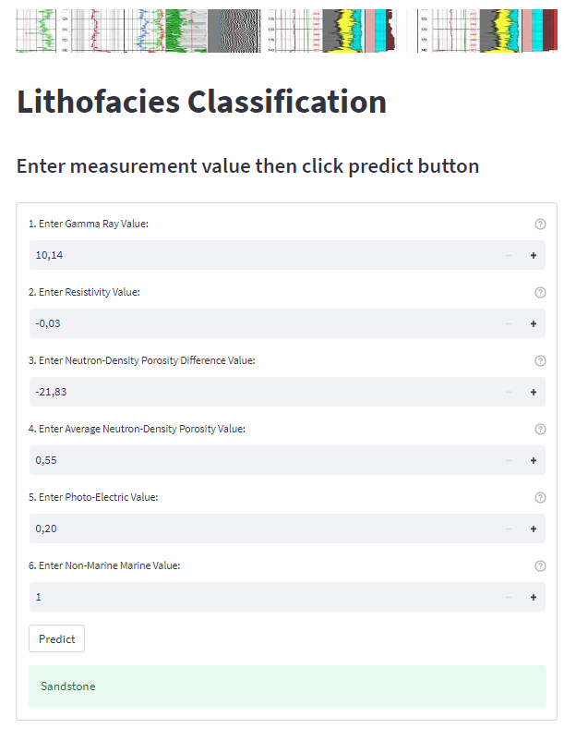
Streamlit : Front End
This project use streamlit as the front end of machine learning application
Streamlit runs on port 8501
Streamlit will sent api data into fast api and receive prediction result of the model

Slide 27
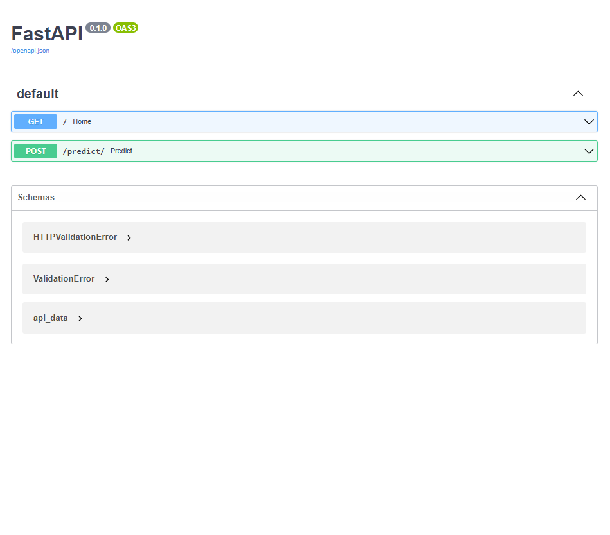
Fast API : Back End
Fast API was use as application peripheral interface for the machine learning model
Fast API receive API data in JSON format from streamlit. Then format the data so the machine learning model could make prediction
After prediction Fast API will sent again the data to streamlit for display

Slide 28
Pytest

Slide 29
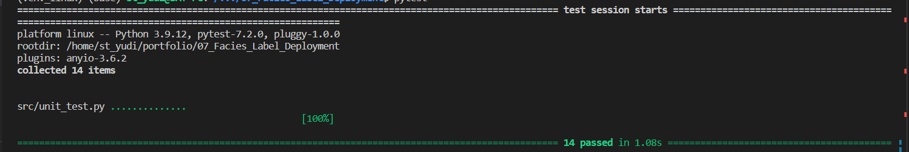
Unit Test Function
Unit test was used to test every function in data_preprocessing.py and feature_engineering.py function as expected
This project uses the pytest library on 14 functions in both data_preprocessing.py and feature_engineering.py and all pass the unit test

Slide 30
Deployment

Slide 31
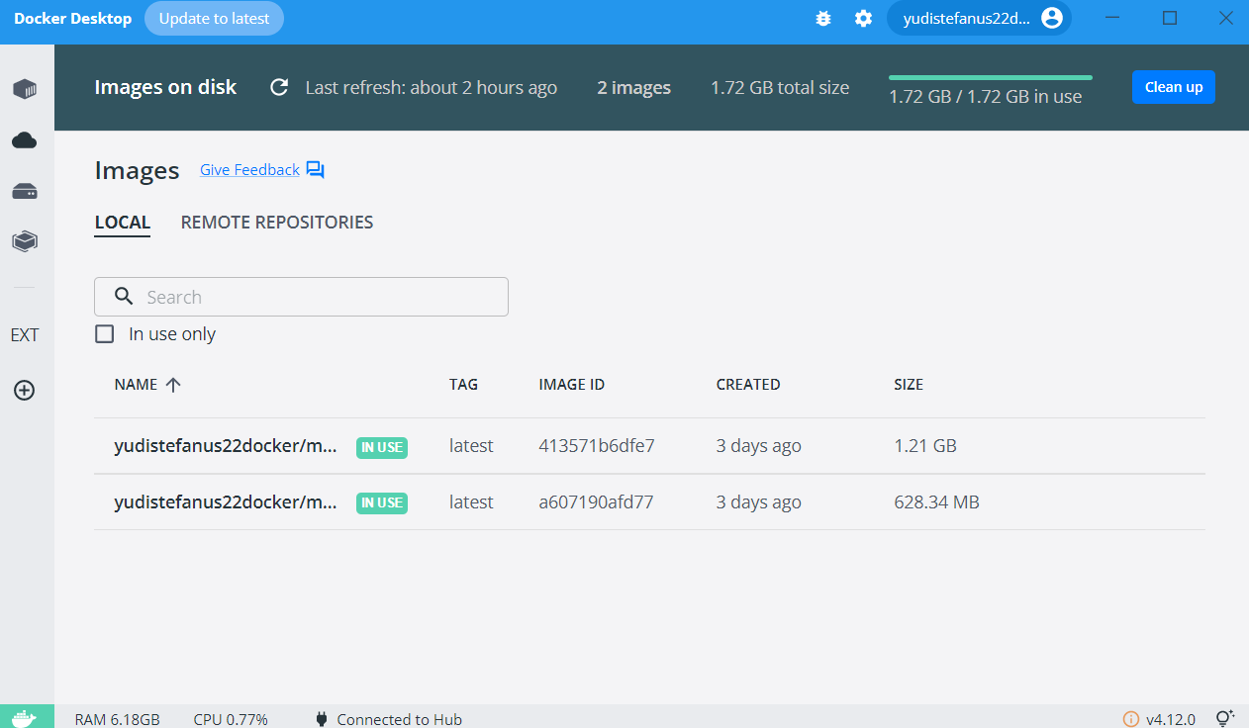
Docker Compose
This development use docker to run the Front end and back end services
Docker function as a container so the front end and back end services can be run at any operating system as long as they have docker
Front end and back end run on separate docker in a time

Slide 32
Reference
[1] Imamverdiyev, Y., Sukhostat, L., 2019, Lithological facies classification using deep convolutional neural network. Journal of Petroleum Science and Engineering 174 (2019) 216–228
[2] M. Gifford, C. Agah, A., 2010, Collaborative multi-agent rock facies classification from wireline well log data, Engineering Applications of Artificial Intelligence 23 (2010) 1158–1172
[3] W. Dunham, M. Malcolm, A. Kim Welford, J. 2020, Improved well log classification using semisupervised Gaussian mixture models and a new hyper-parameter selection strategy, Computers and Geosciences 140 (2020) 104501
[4] W.J. Glover P., K. Mohammed-Sajed, O., Akyiiz, C., Lorinczi, P. 2022, Clustering of facies in tight carbonates using machine learning, Marine and Petroleum Geology 144 (2022) 105828
[5] Antariksa, G. Muamar, R. Lee, J. 2022, Performance evaluation of machine learning-based classification with rock-physics analysis of geological lithofacies in Tarakan Basin, Indonesia, Journal of Petroleum Science and Engineering 208 (2022) 109250
Notes:
This is my reference for completing this analysis

Slide 33



Slide 34




Reach me !
For discussion
Project Notebook and Repository
My-Resume
Project-Repository
My-Email
My-LinkedIn

